Slide 1
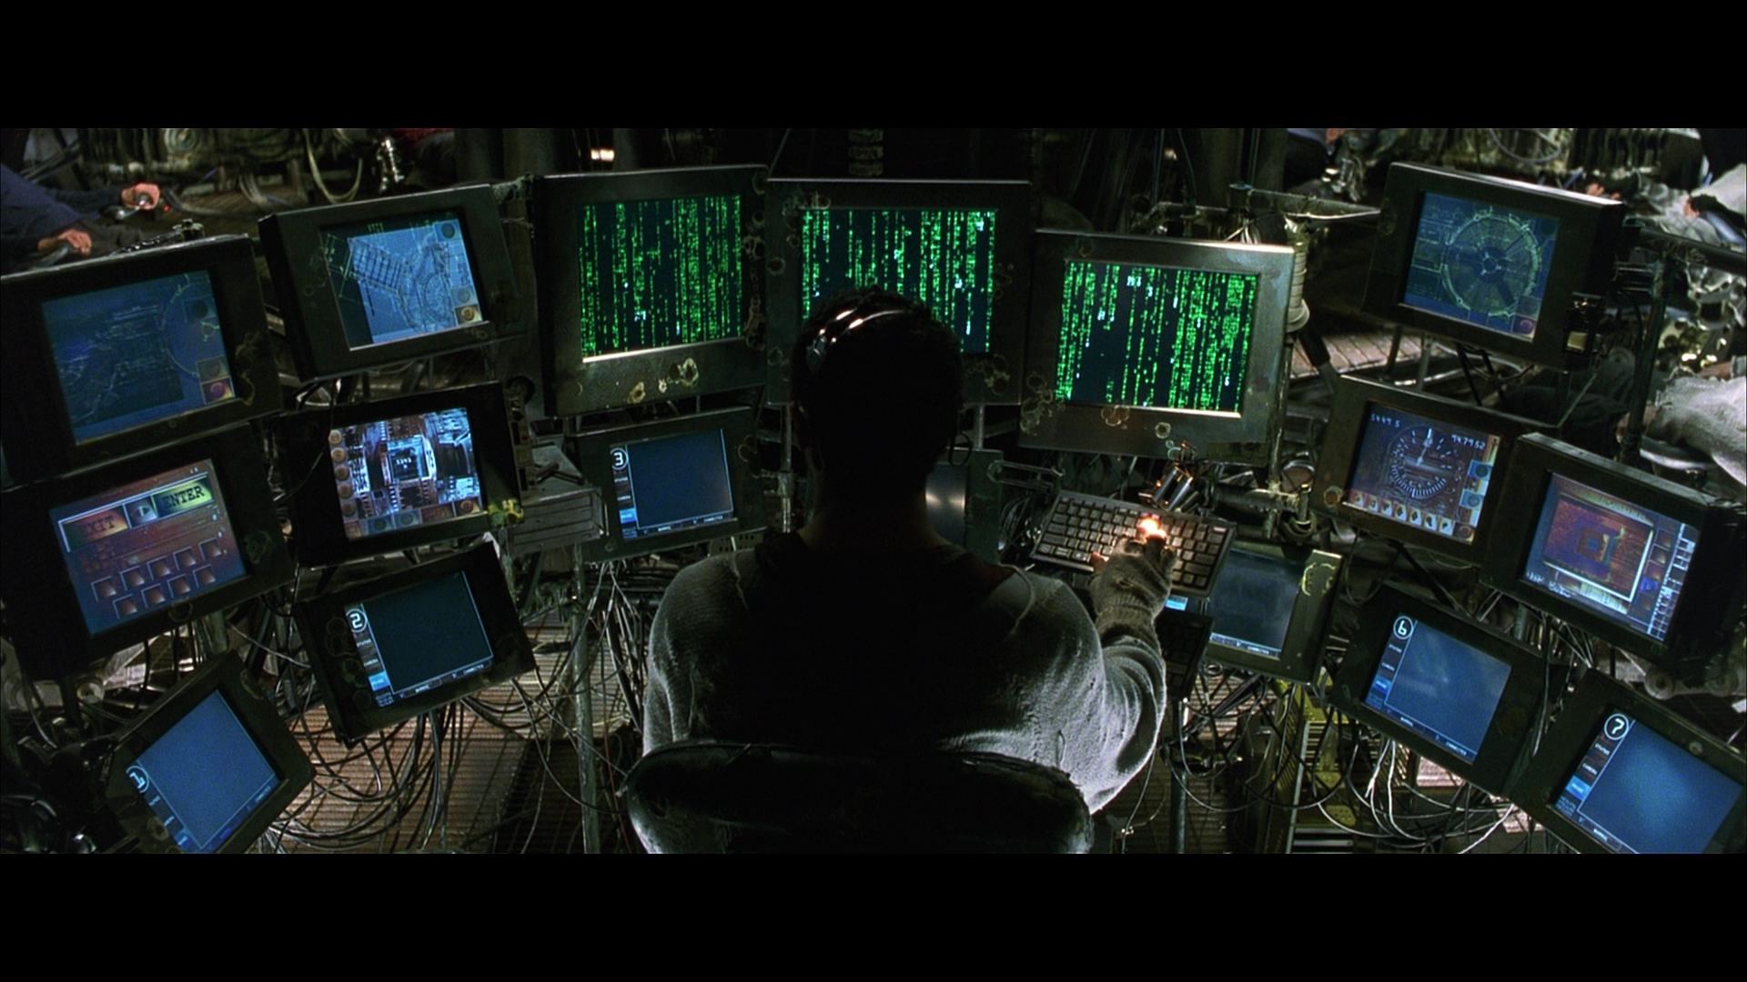
SoftwareTailor
”Do you believe in fate?”
”No”
”Why?”
”Because I don’t like the idea that I’m not in control of my own life.”

Slide 2
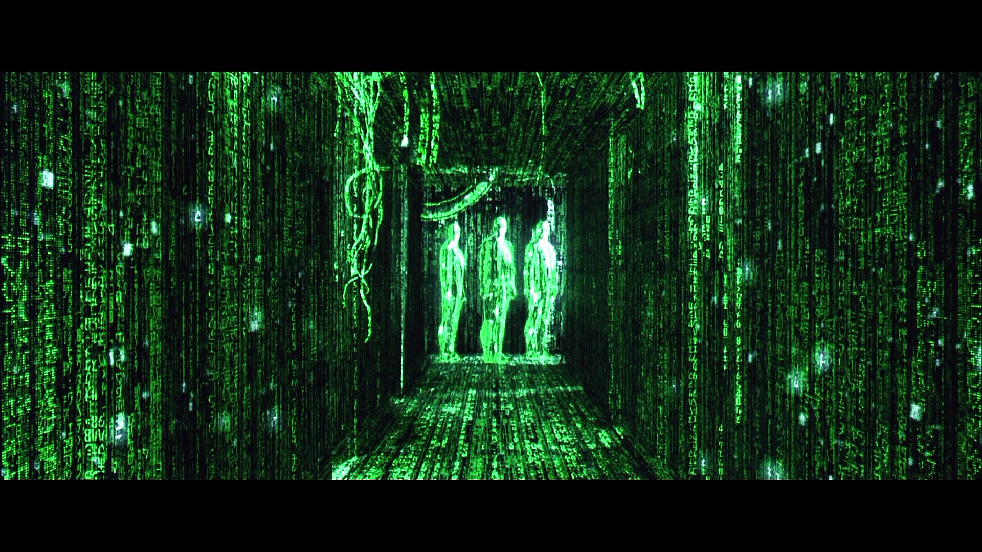
“Not everyone believes what you believe.”
“My beliefs do not require them to.”
SoftwareTailor

Slide 3
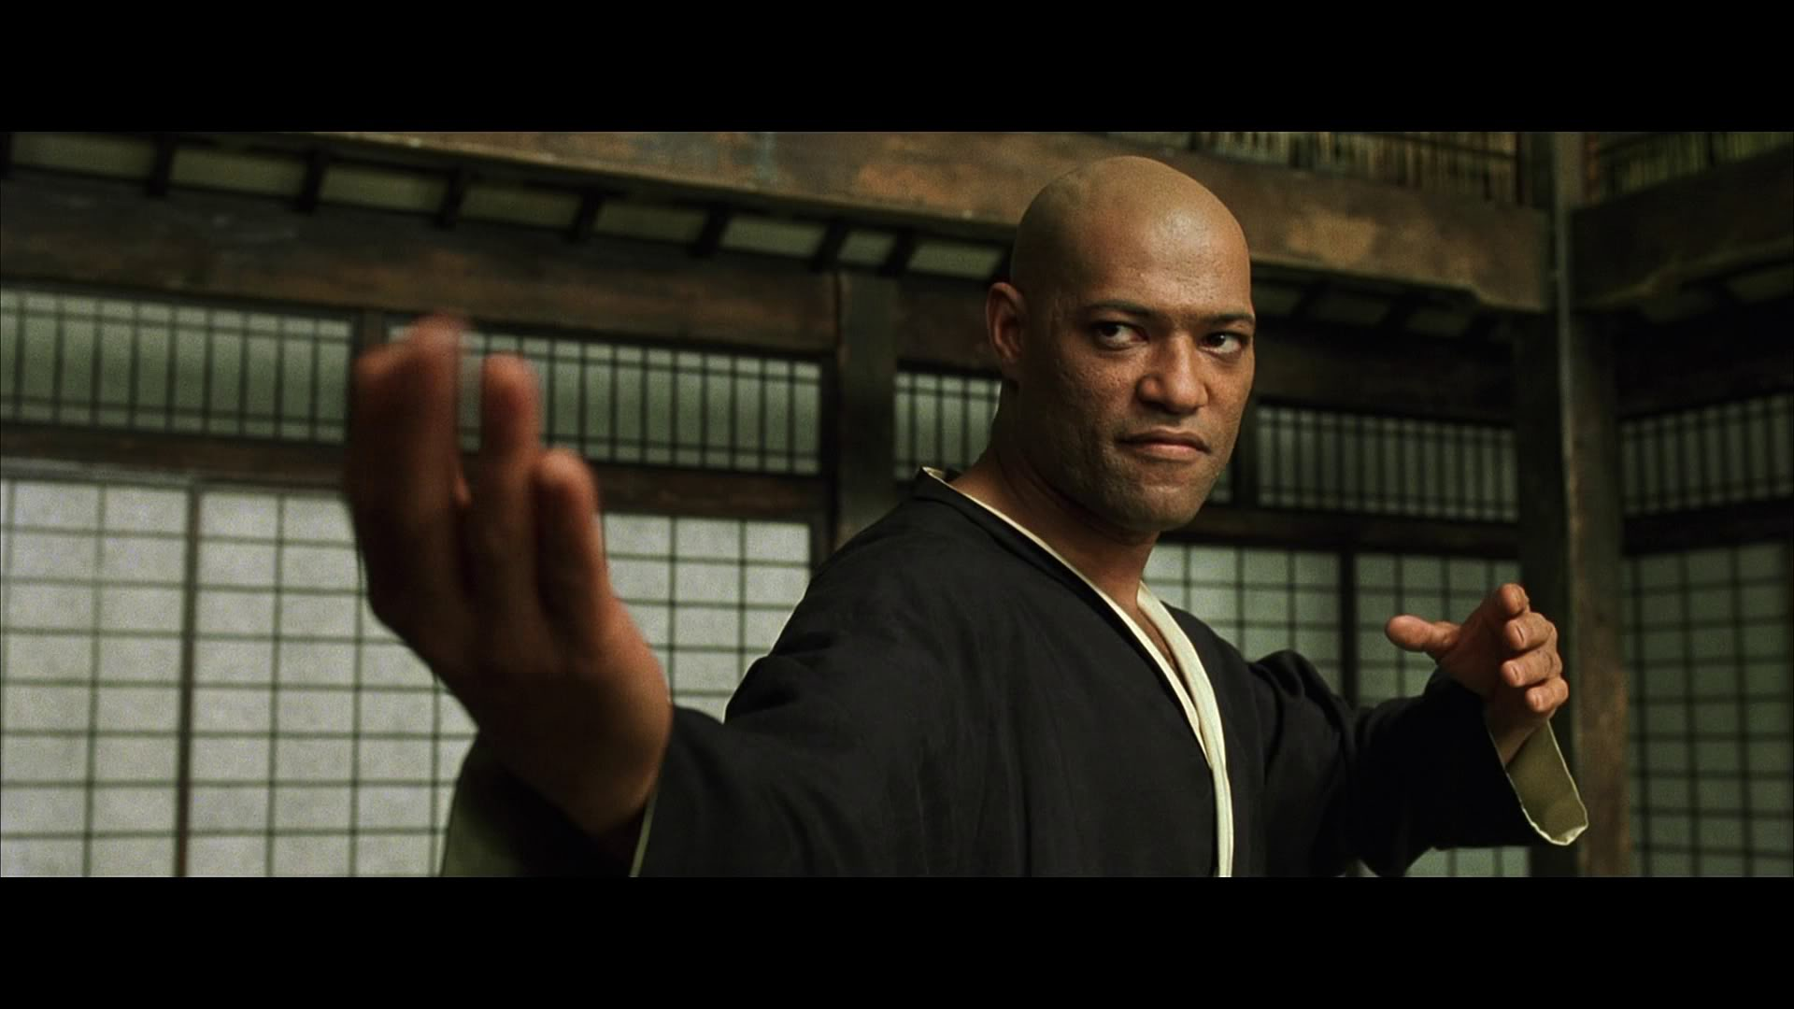
I’m trying to free your mind…..but I can only show you the door. You’re the one that has to walk through it.
SoftwareTailor

Slide 4
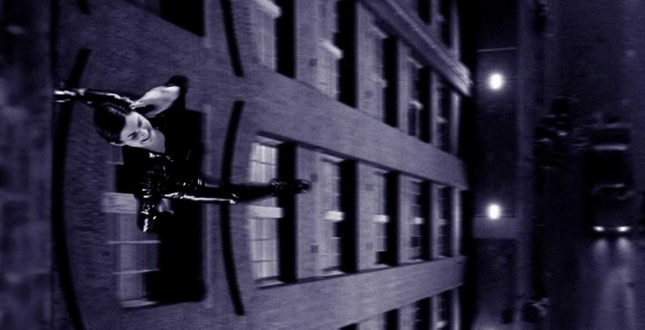
You have to let it all go.
Fear….. doubt….. and disbelief.
Free your mind….
SoftwareTailor

Slide 5

You know that road. You know exactly where it ends. And I know that’s not where you want to be.
SoftwareTailor

Slide 6
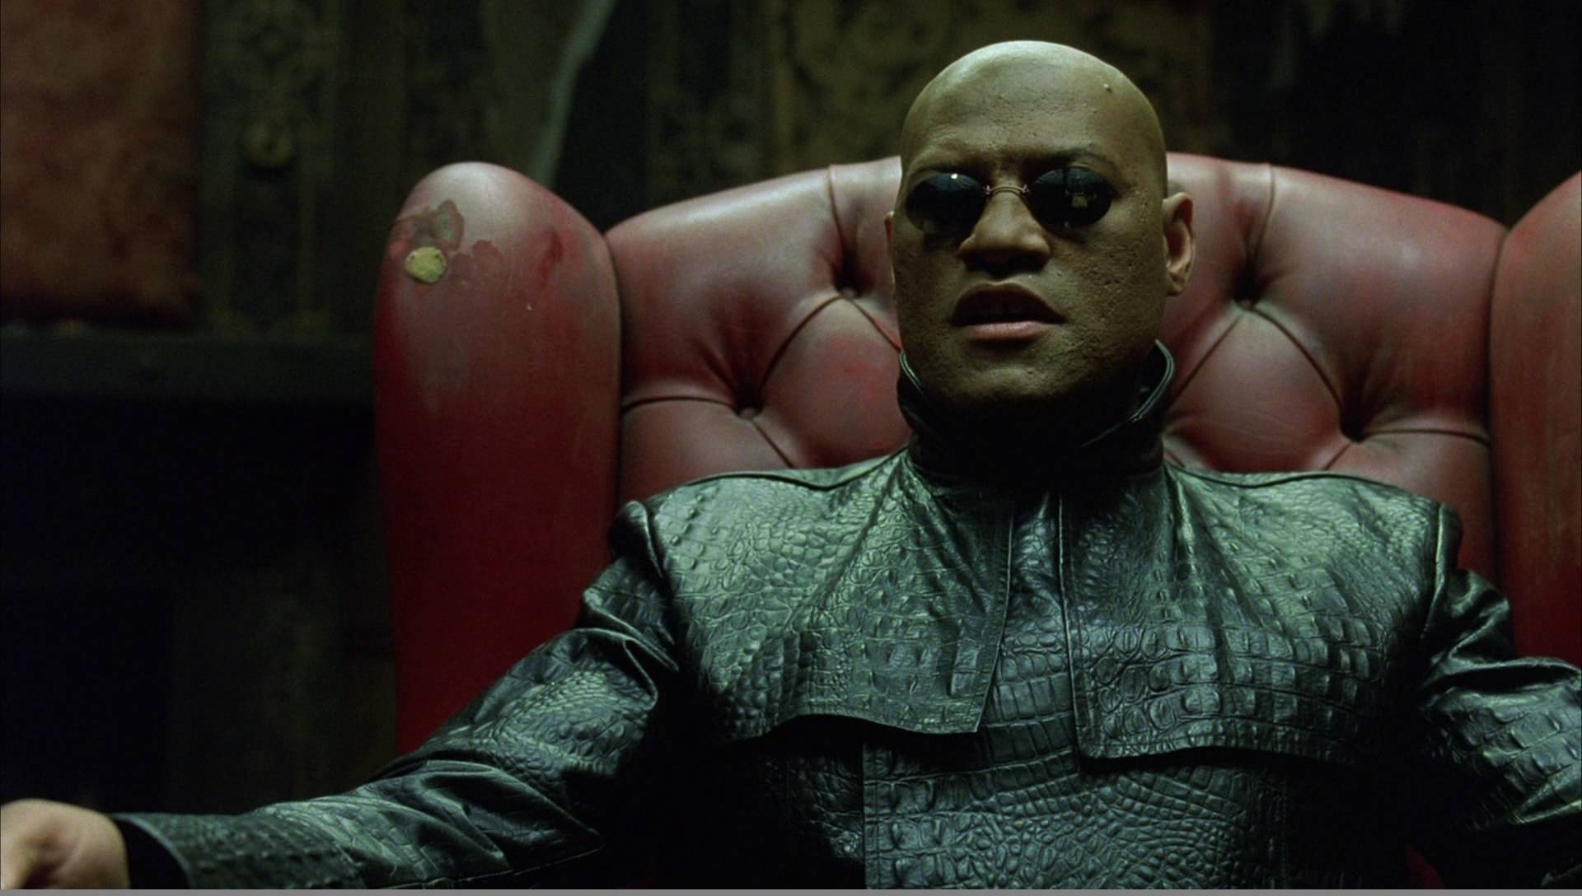
I can guide you, but you must do exactly as I say.
SoftwareTailor

Slide 7
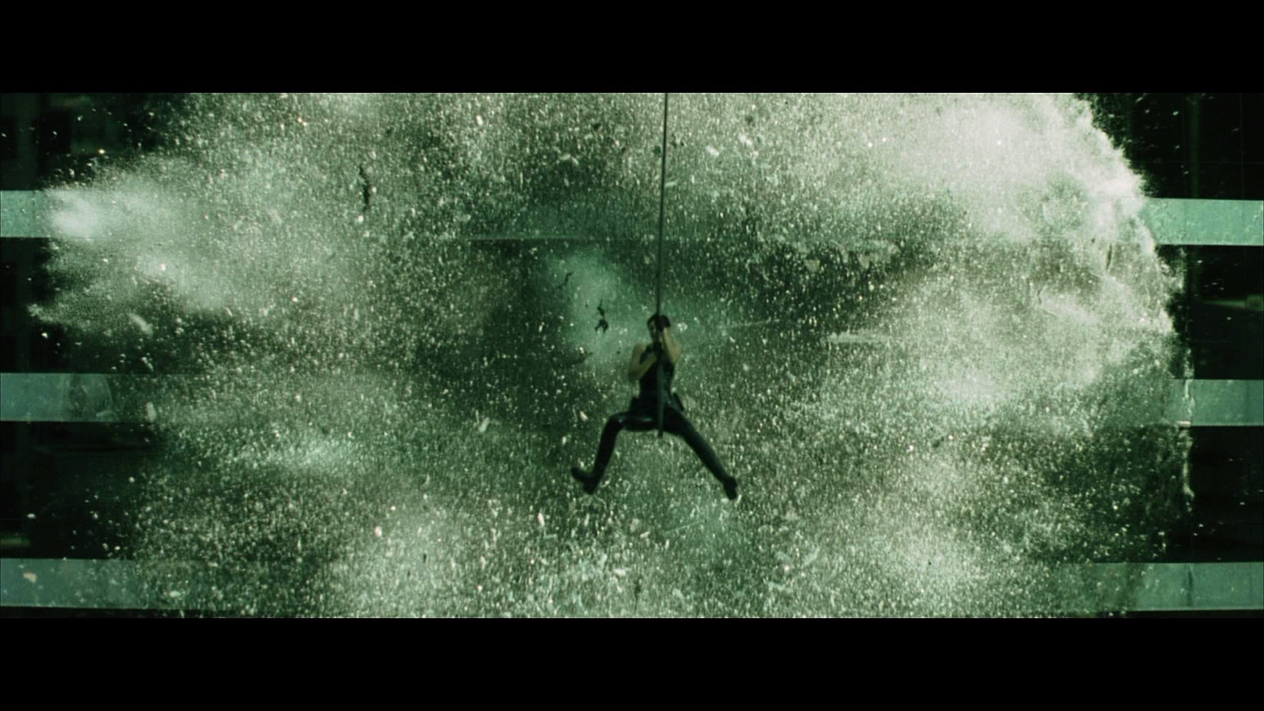
There’s a difference between knowing the path and walking the path.
SoftwareTailor

Slide 8
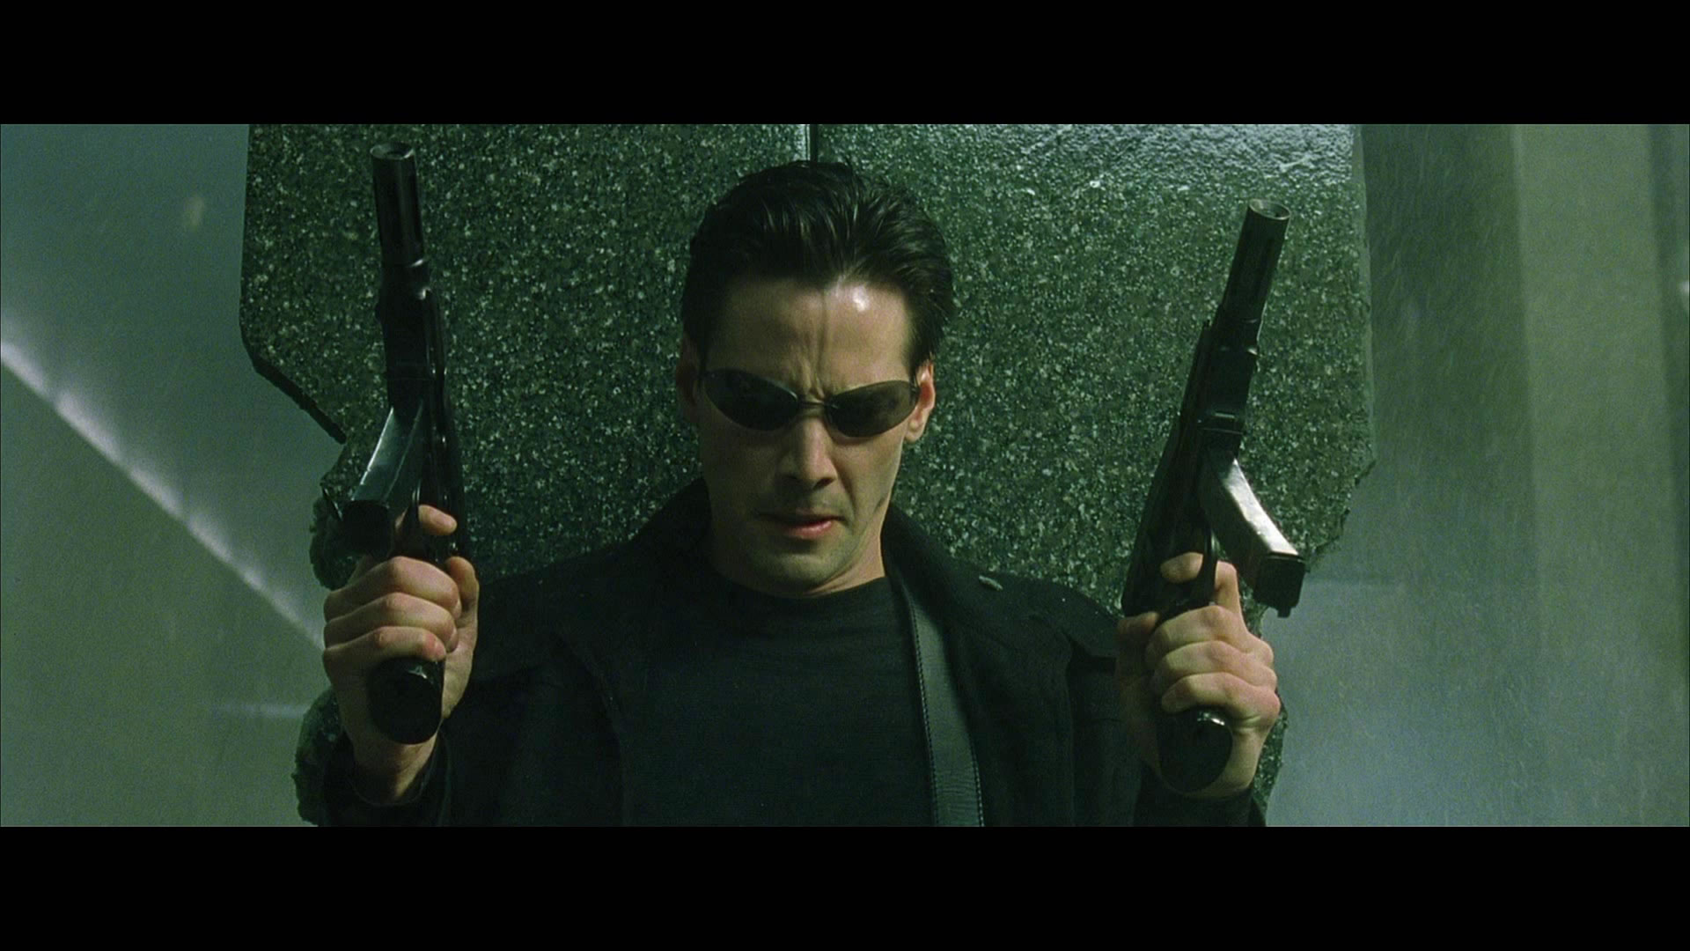
“I hope you’re right.”
“I do not believe it to be a matter of hope. It is simply a matter time.”
SoftwareTailor

Slide 9
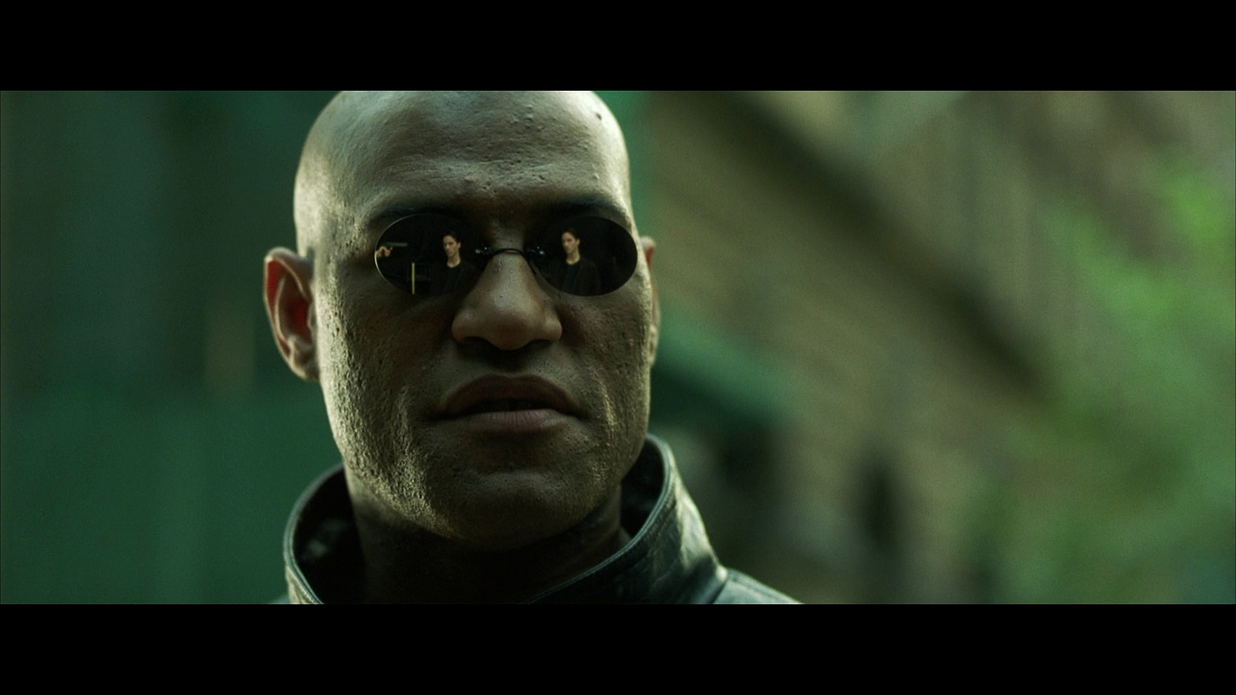
SoftwareTailor
I can see it in your eyes. You have the look of a man who accepts what he sees, because he is expecting to wake up.

Slide 10
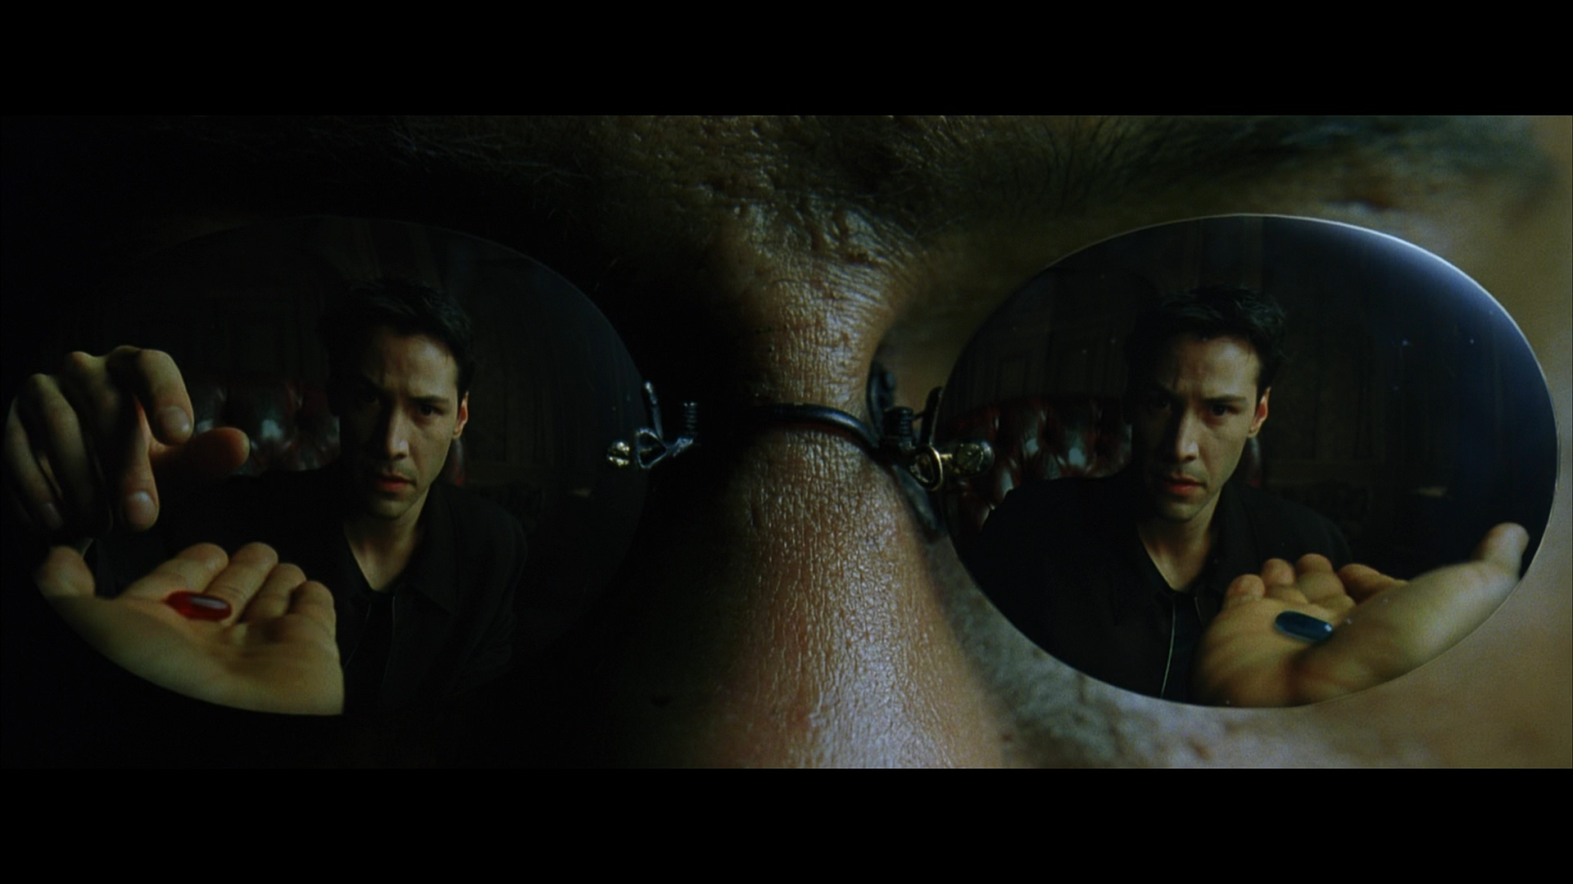
You take a chance either way. I leave it to you.
SoftwareTailor

Slide 11
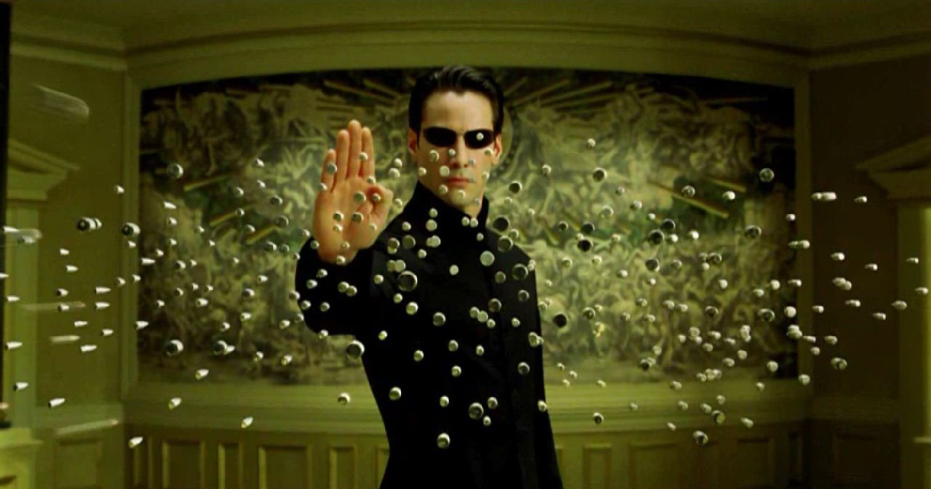
The truth. No one will panic, because nothing to fear.
SoftwareTailor

Slide 12
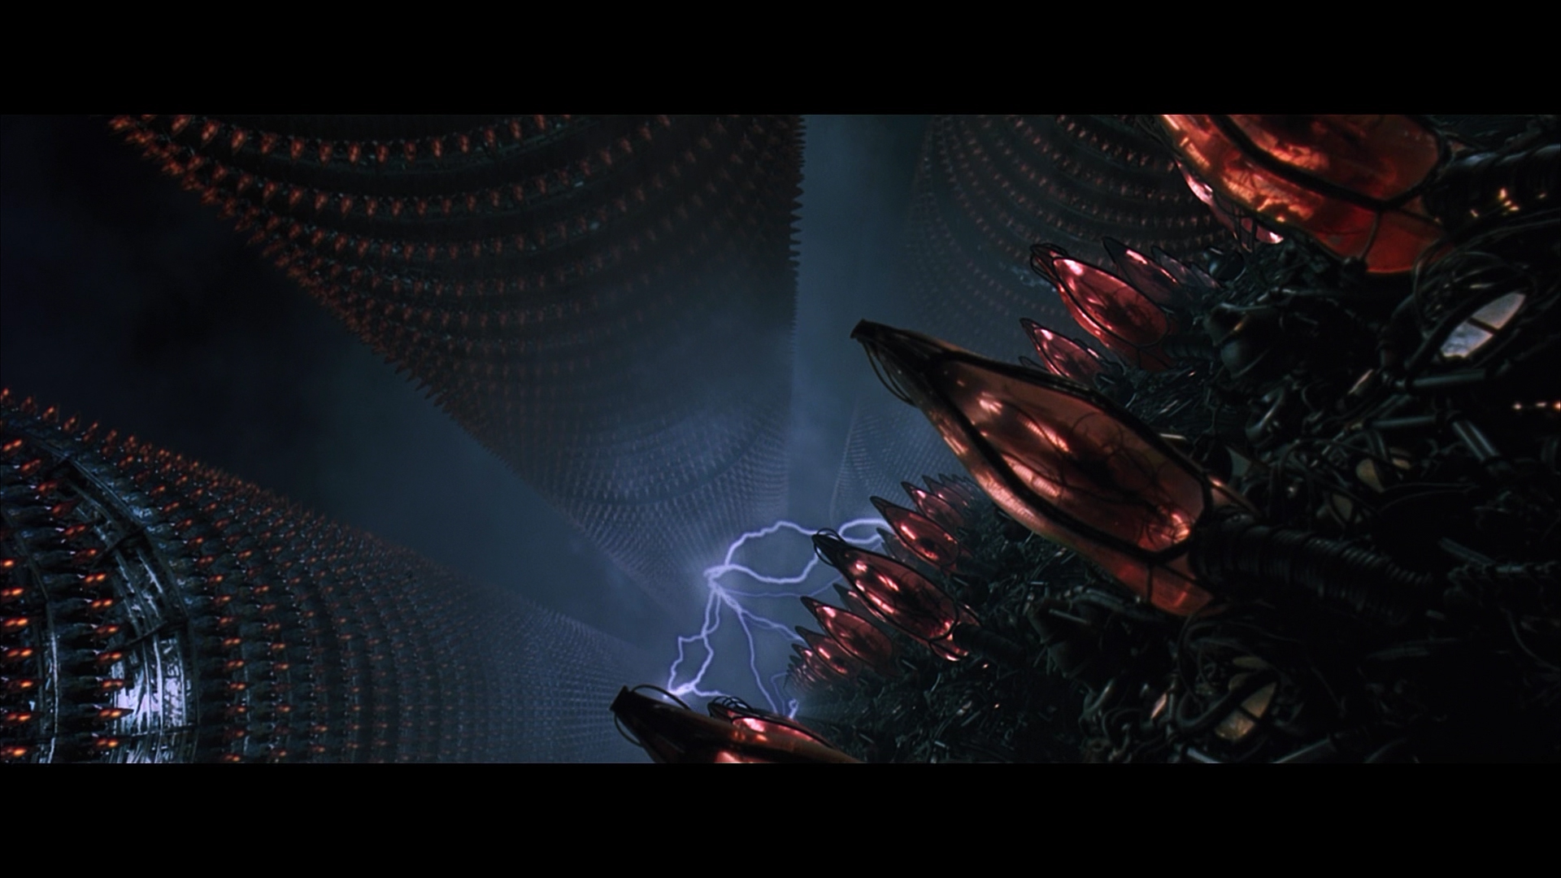
SoftwareTailor
Try not to think in terms of right or wrong.

Slide 13
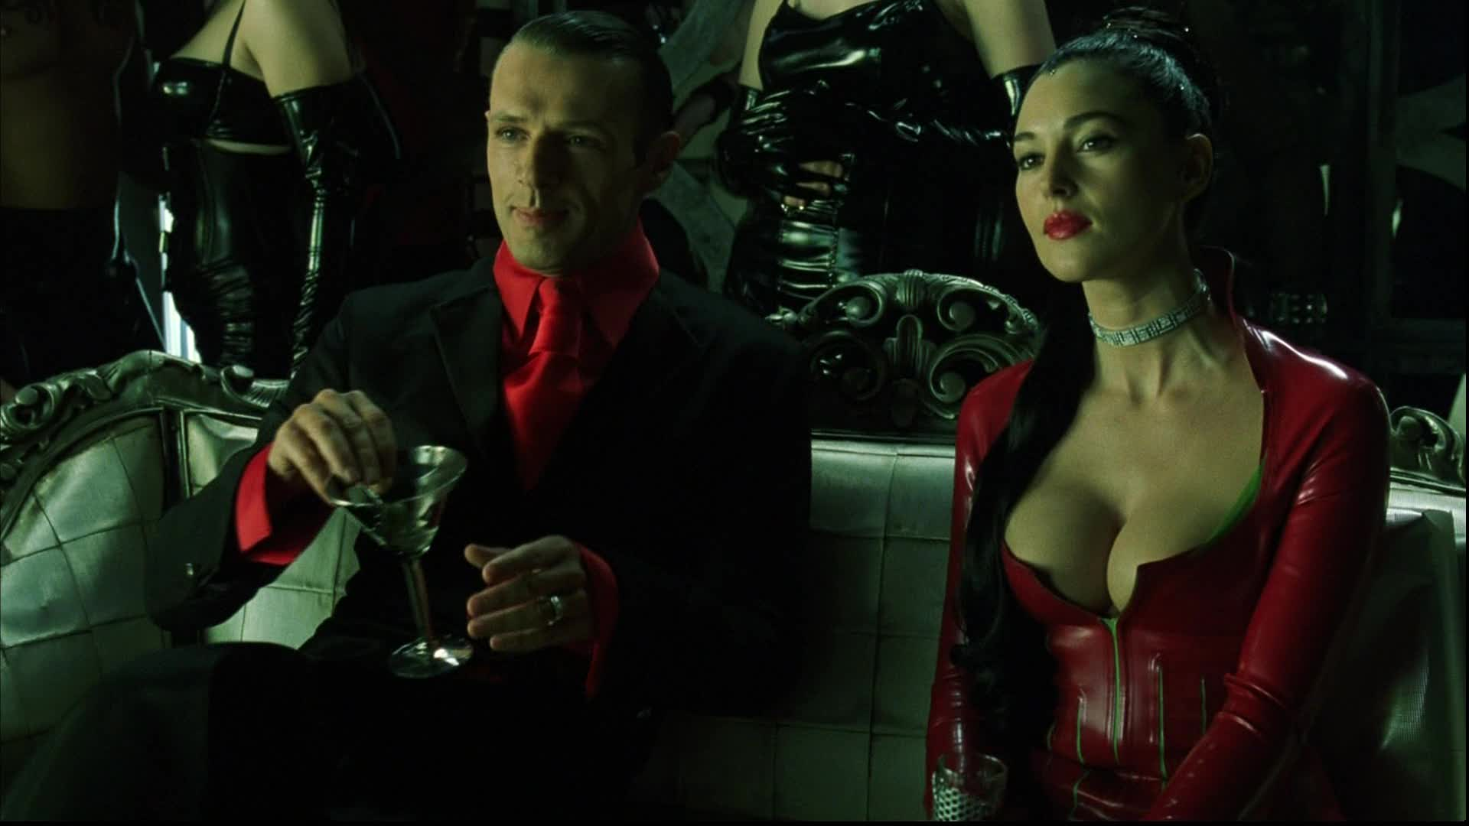
SoftwareTailor
This path has been placed before you. The choice is yours alone.

Slide 14
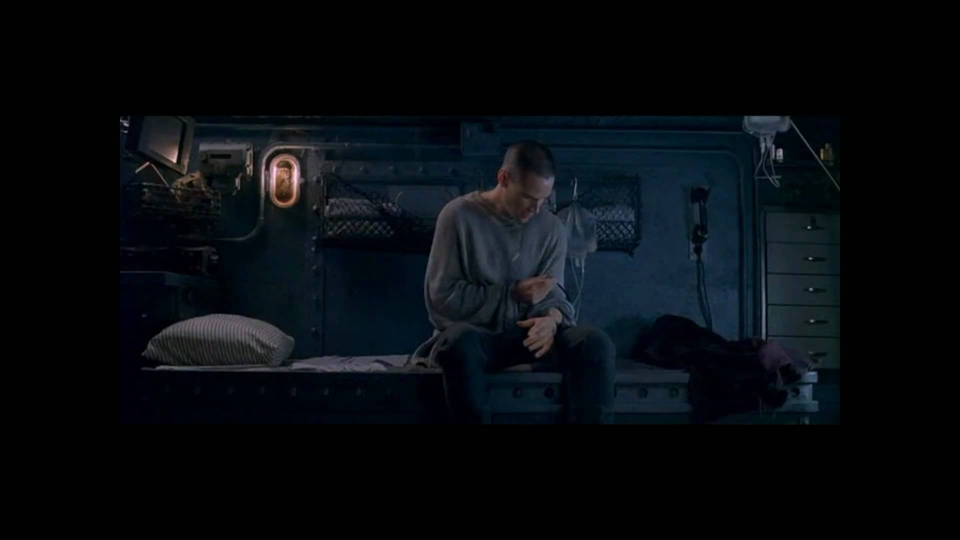
SoftwareTailor
”My place is here. My future is here. It’s time for you to let go.”
“I don’t want things to change.”
“But you can’t stop the change….any more than you can stop the suns from setting.”

Slide 15
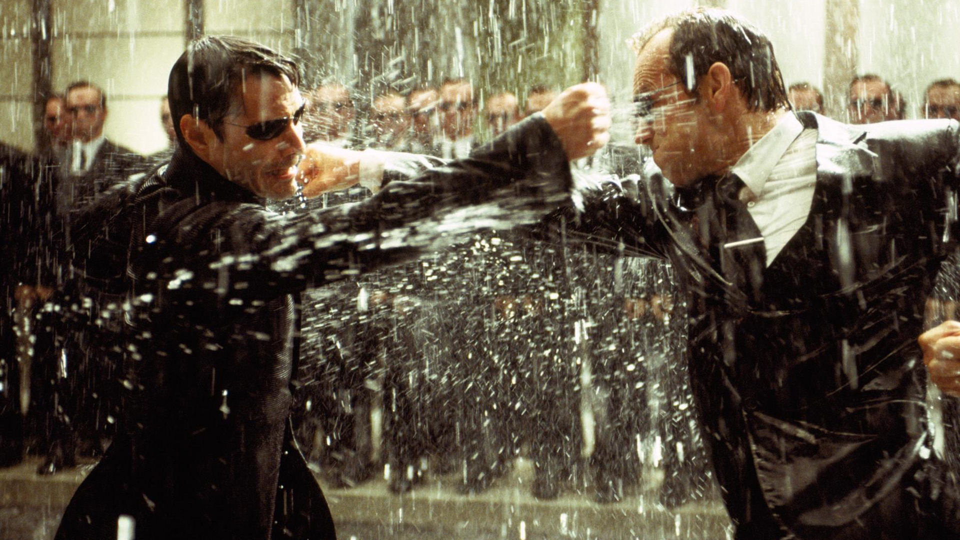
SoftwareTailor
Don’t worry about it. As soon as you step outside this door, you’ll remember you don’t believe in any of this fate crap. You’re in control of your own life.

Slide 16
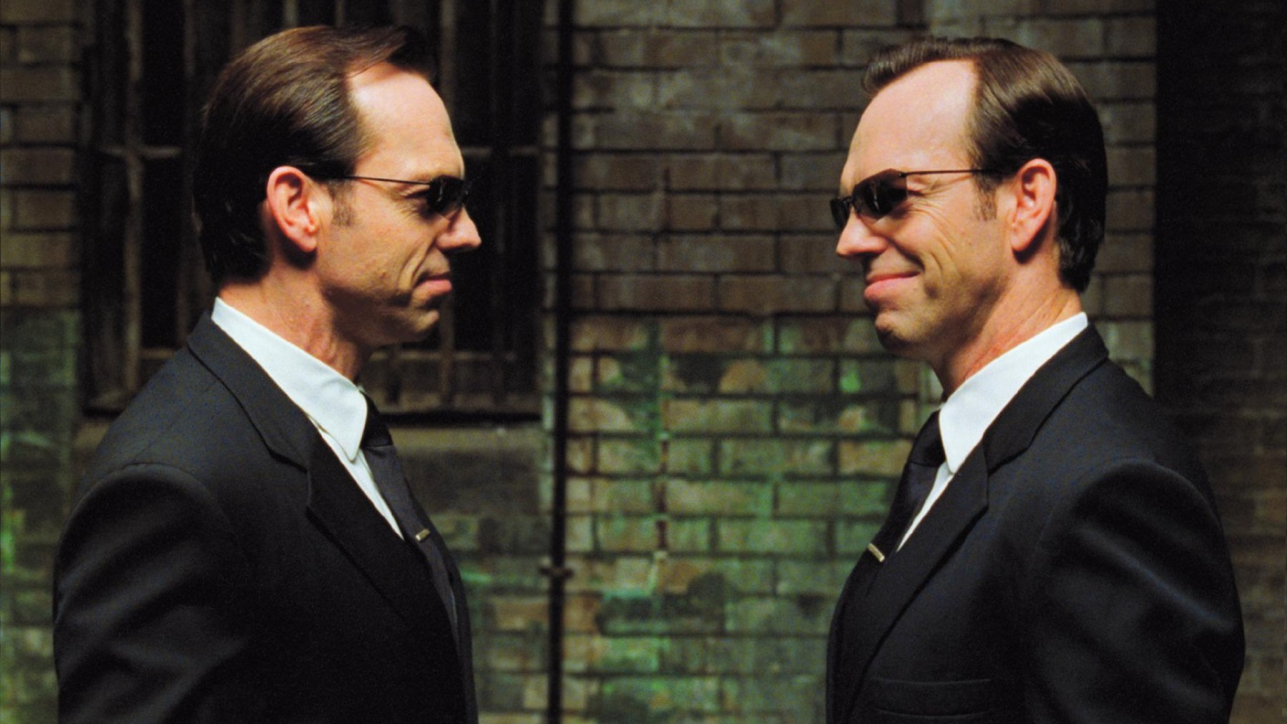
SoftwareTailor
You move to an area and you multiply and multiply until every natural resource is consumed. The only way you can survive is to spread to another area. There is another organism on this planet that follows the same pattern. A virus. Human beings is a disease. A cancer of this planet. You are a plague.

Slide 17
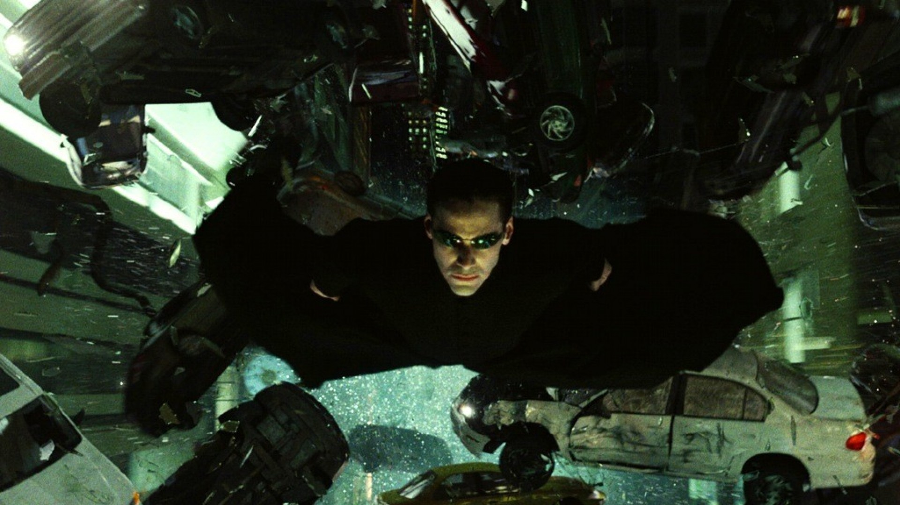
SoftwareTailor
You have brought hope to those who have none.

Slide 18
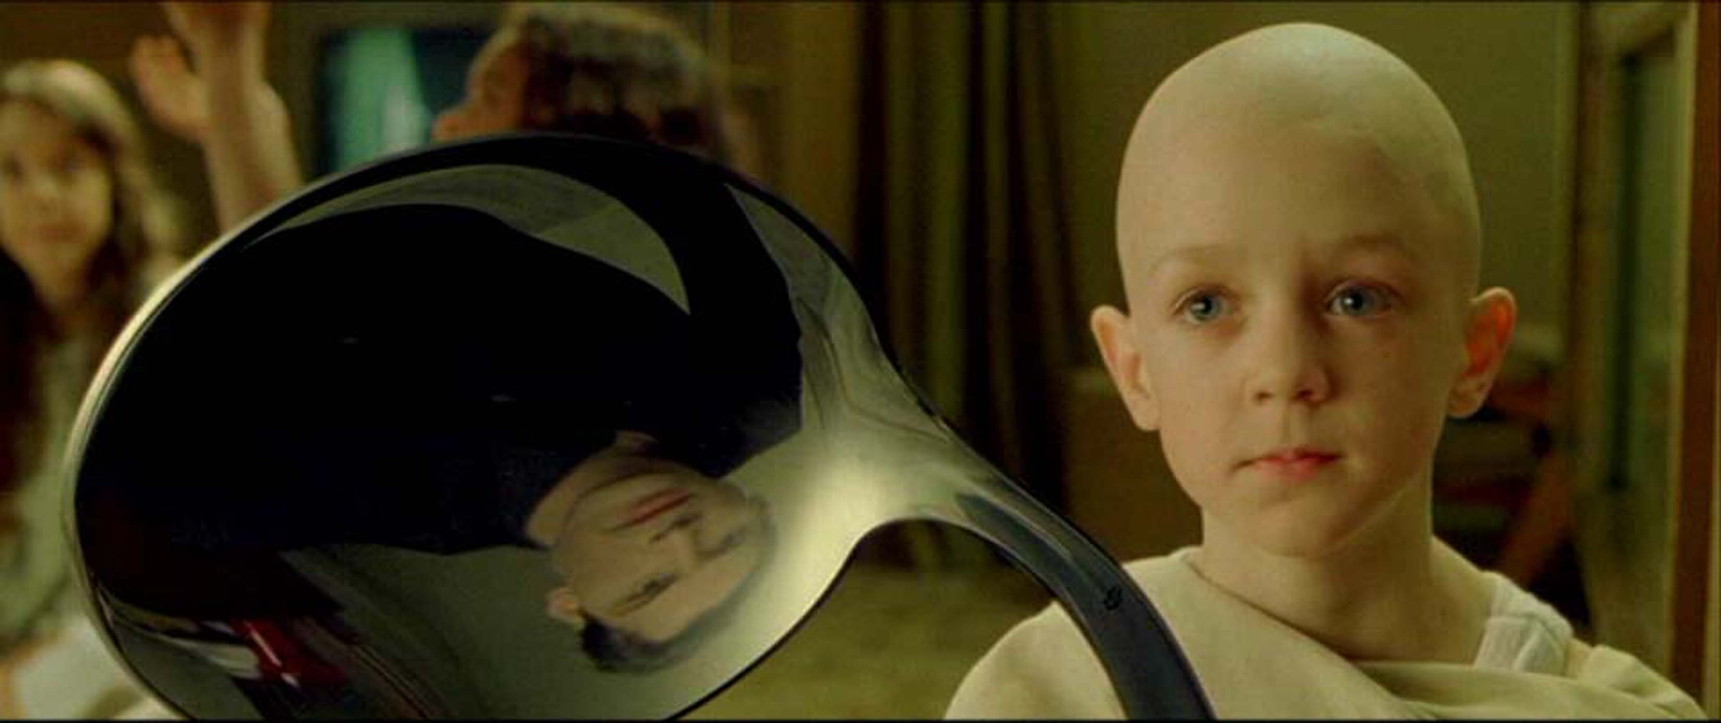
Do not try and bend the spoon. That’s impossible. Instead, only try to realize the truth. There is no spoon. Then you’ll see that it is not the spoon that bends. It is only yourself.
SoftwareTailor

Slide 19
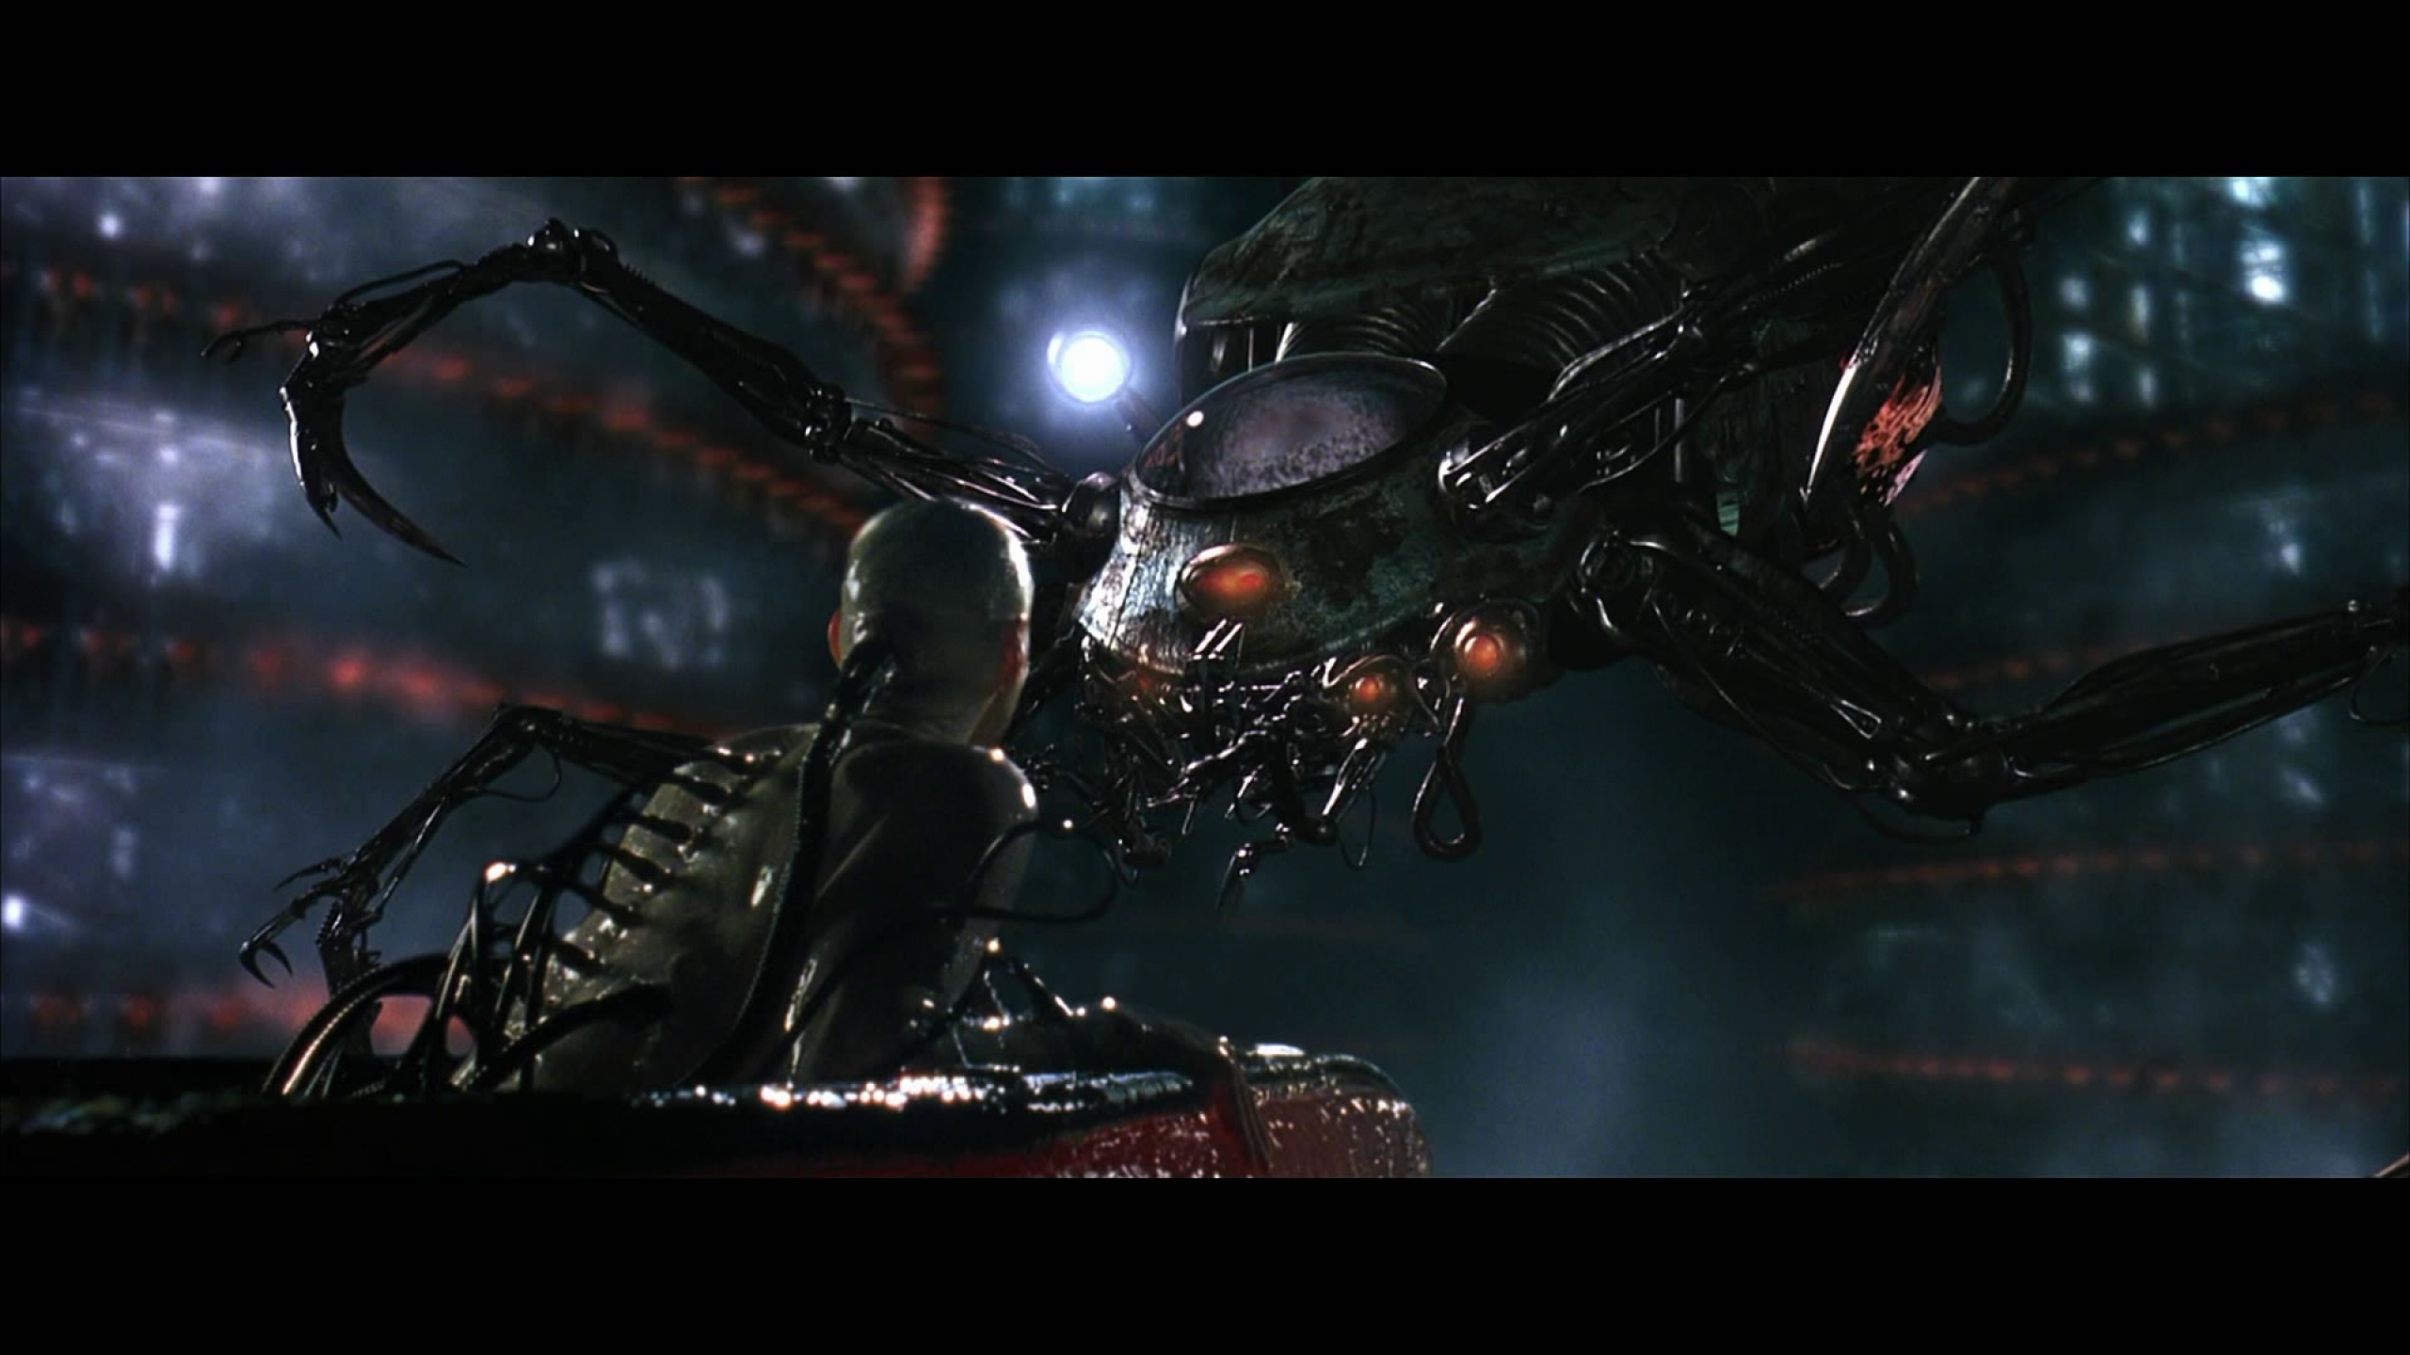
Believe me when I say we have a difficult time ahead of us. But if we are to be prepared for it, we must first shed our fear of it. I stand here before you now truthfully unafraid. Why? Because I believe something you do not? No! I stand here without fear because I remember. I remember that I am here not because of the path that lies before me ….but because of the path that lies behind me.
SoftwareTailor

Slide 20
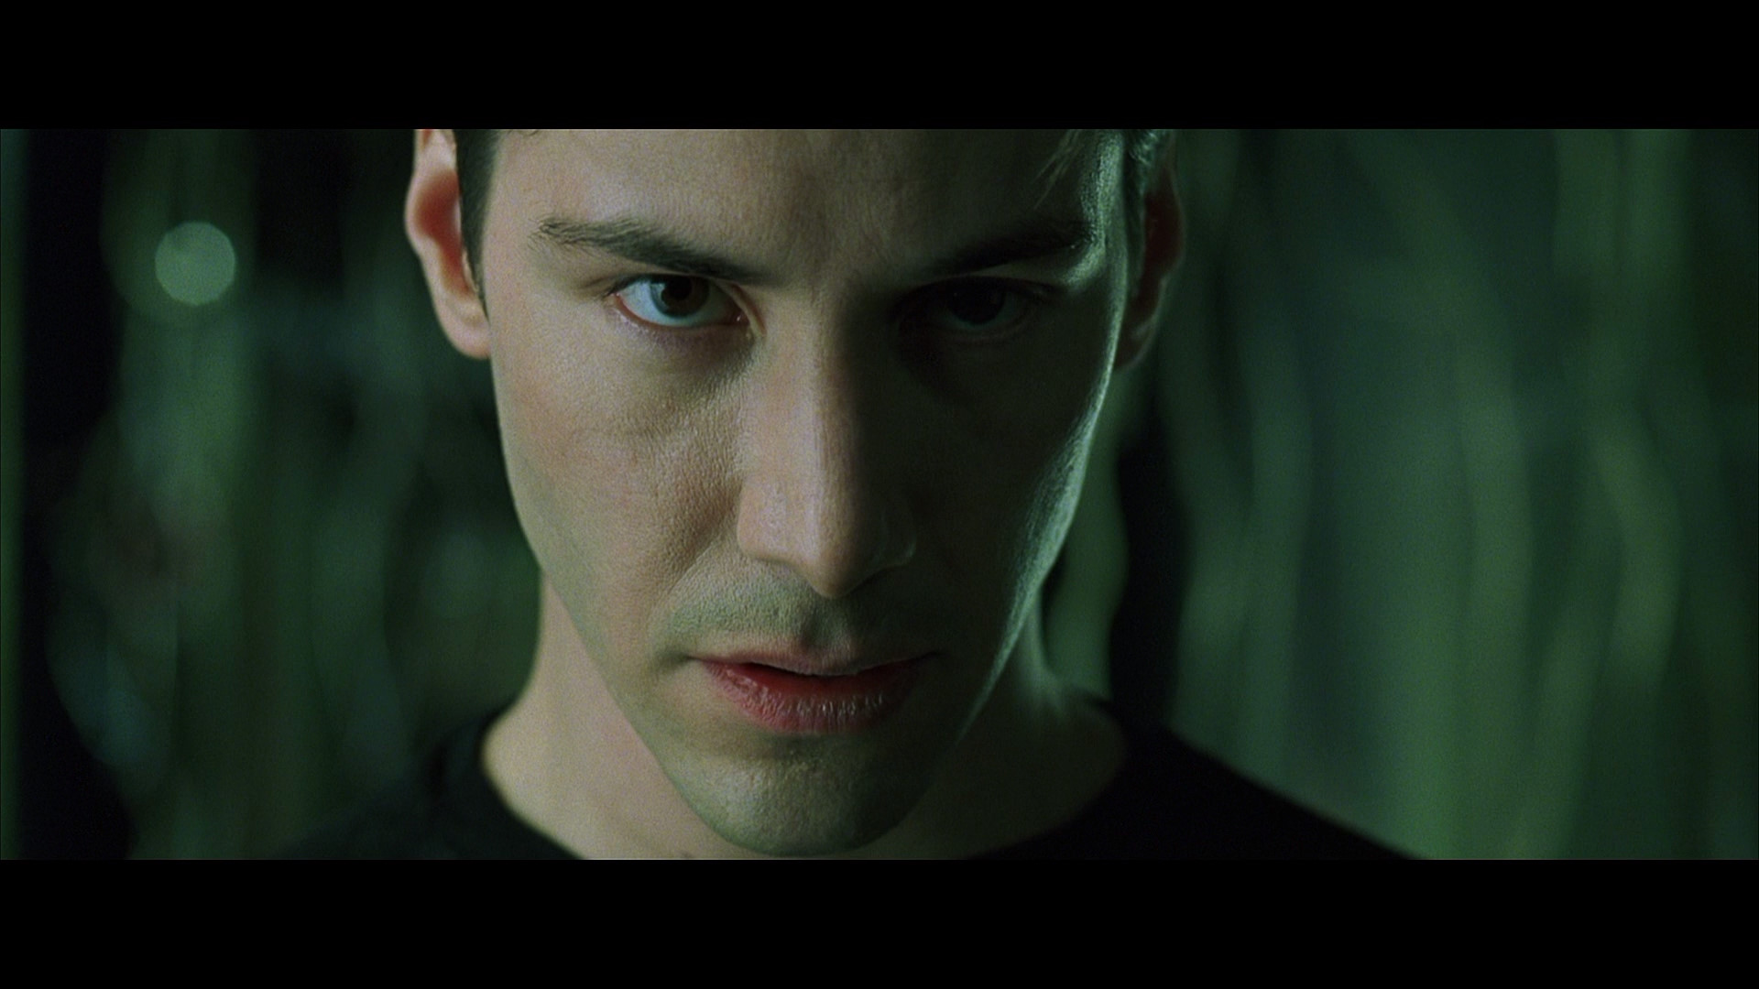
Now, be brave… and don’t look back. Don’t look back.
SoftwareTailor

Slide 21

I know you’re out there. I can feel you now. I know that you’re afraid. You’re afraid of us. You’re afraid of change. I don’t know the future. I didn’t come here to tell you how this is going to end. I came here to tell you how it’s going to begin. I’m going to show you a world without rules and control, without borders or boundaries. A world where anything is possible. Where we go from there is a choice I leave it to you.
SoftwareTailor

